Slide 1

cuba
By: alec alsager

Slide 2
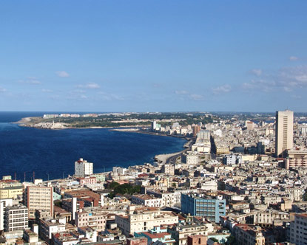
Cuba’s capital city is havana

Slide 3
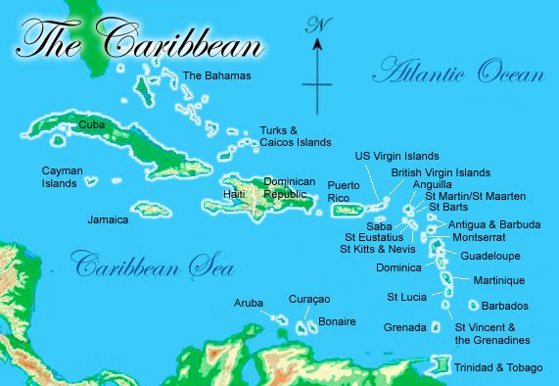
Cuba is the largest state in the Caribbean islands

Slide 4
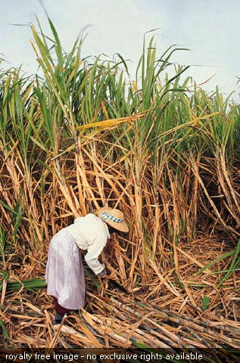
Cuba grows a lot of sugar canes

Slide 5
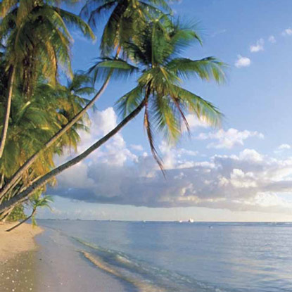
Cuba dose a lot of tourism

Slide 6
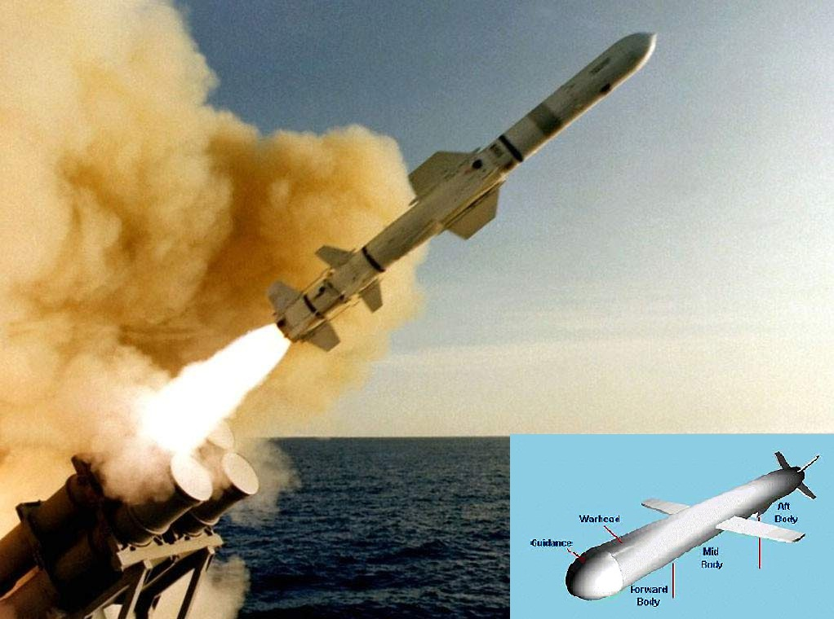
Cuba had a missile crisis in 1992

Slide 7
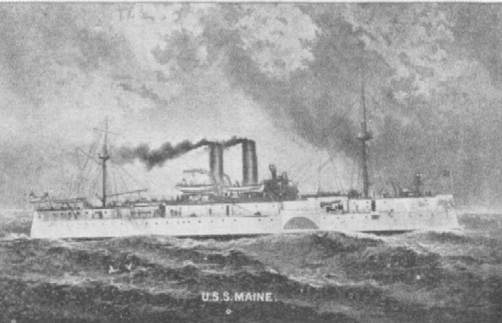
In 1898,the U.S warship Maine exploded.

Slide 8
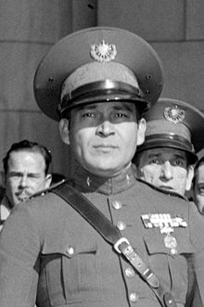
Batista was overthrown on January 1,1959.

Slide 9
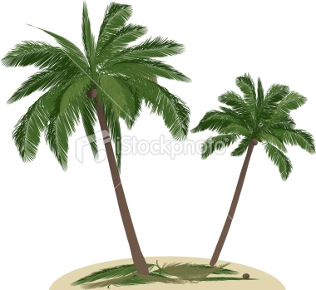
Palm trees are common in cuba.

Slide 10

bye
bye

