Slide 1
All about Brazil!!!!
By: Isabelle Dally and Amaiya Chiles

Slide 2
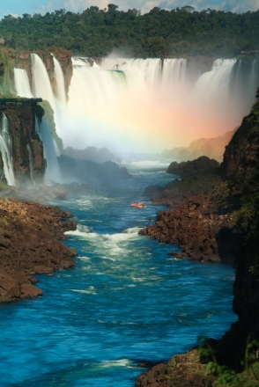

Tourism in Brazil
To Brazil tourism is important
In 2010 more then 5.1 MILLION visitors came from far and wide and wanted to tour in Brazil
Also in 2010 they got 5.9 BILLION dollars from people who wanted to tour in brazil now that is a Ton of money!
=

Slide 3

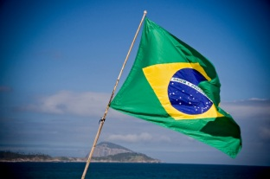





Population
Now if you think that Brazil does not have many people you are WRONG….
IT HAS 194.946 MILLION PEOPLE !!! ( Boy how crowed is it?)
It is because Brazil is a very large country

Slide 4


Major Imports and Exports
Machinery, Electrical things, Transport things, chemicals, Oil, Car parts, And electronics
Iron Ore, soy beans, Footwear, Coffee, and autos
Imports
Exports

Slide 5
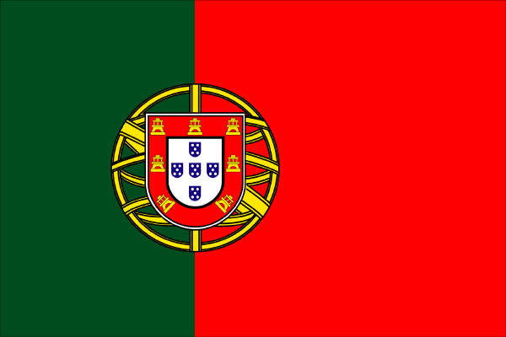

Languages spoken
Spanish
Portuguese( It is close but not the same!)

Slide 6
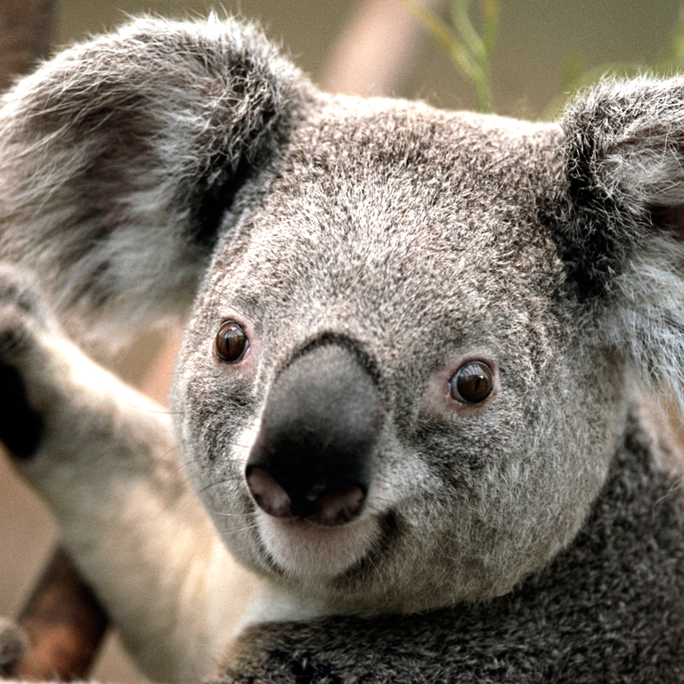
Agriculture
Coffee, Soybeans, Wheat, Rice, And corn

Slide 7
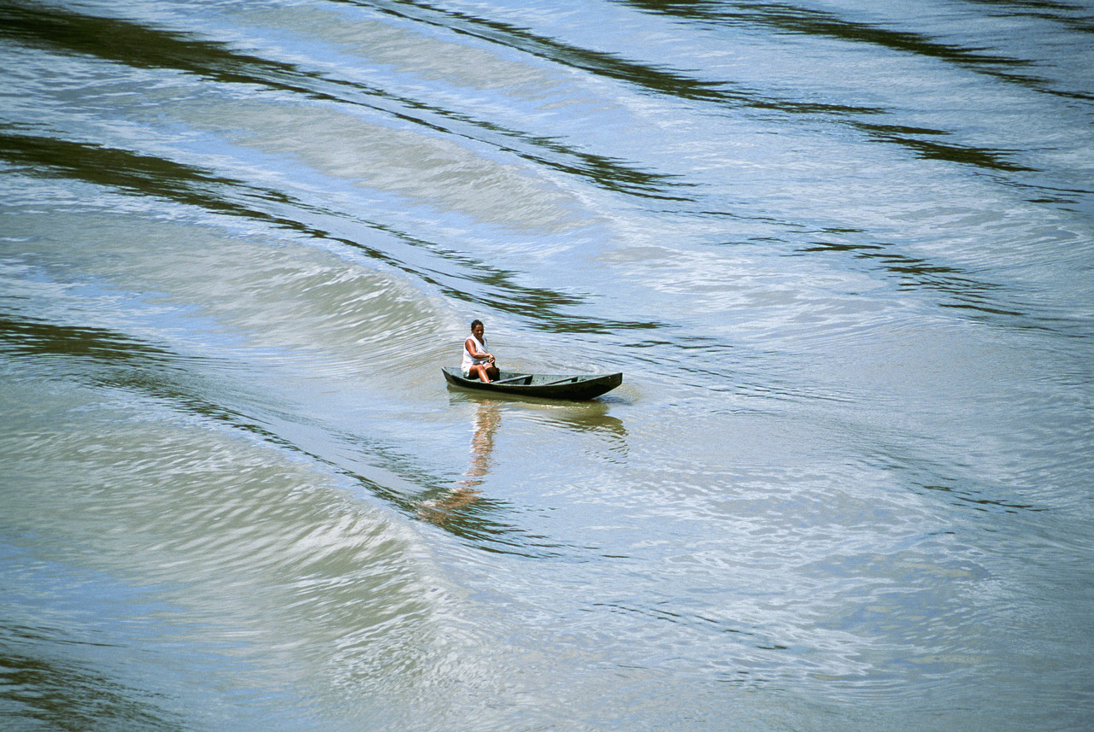
The Coasts
Mountains deserts valleys of brazil
The Amazon River and a lot more like: Amazon river basin, the Brazilian highlands, and the highest point Porto rico

Slide 8


Major Holidays
CHRISMAS!!!!!!

Slide 9


History
The portages were first there ( That is why they spoke that) and they found the native Americans.

Slide 10


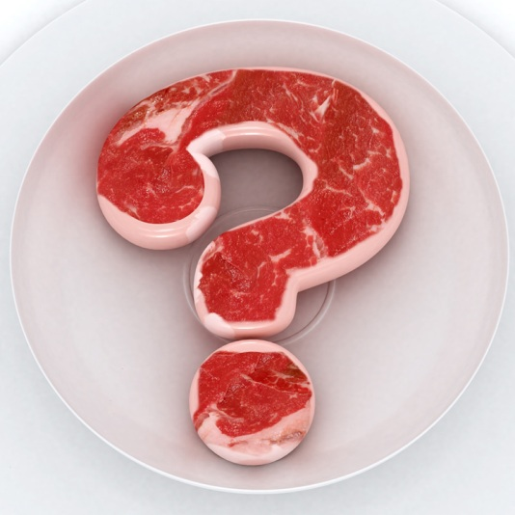


The explorers of brazil
?????? ( No one knows ) :0

Slide 11


Typical foods of Brazil
Main foods:
Acaraje
Churrasco
Coxinha
Feijoado
Fruit
Meat
Monque
Pamonba
Pao de jueijo
Pidino de jacare
PIZZA!!!!!!!!!!!!!!

Slide 12

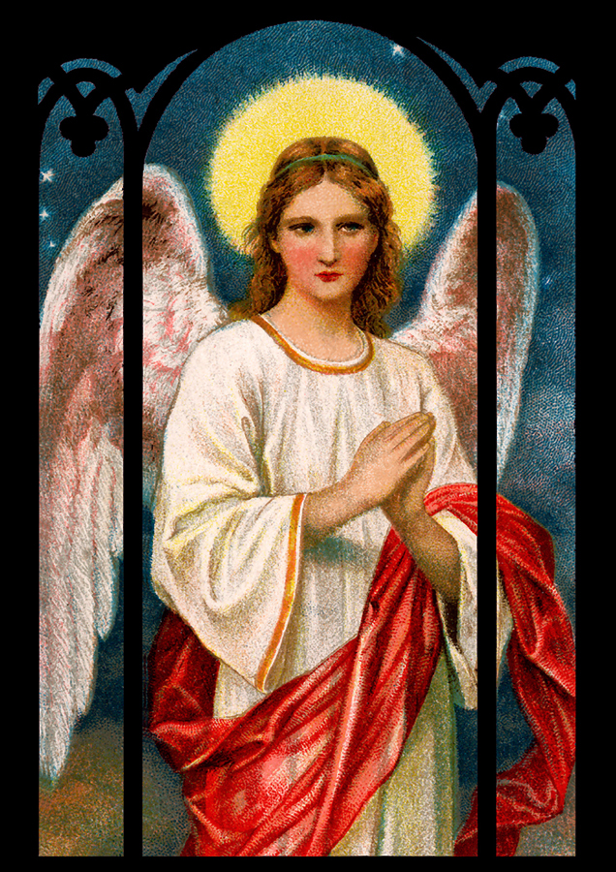
Religion ( Famous ) of Brazil
Roman Catholic

Slide 13

Later…
Brazil is still good and standing and it will still be well

Slide 14
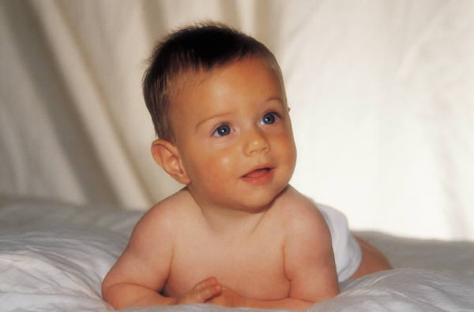
The end
Be sure to wish Jeffrey a Jeffrey-day thingie
(He wants chocolate and cookies)

