Slide 1
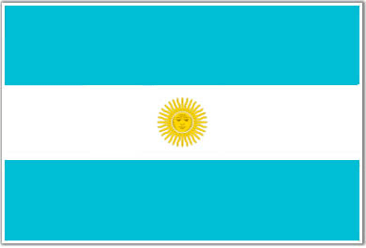
Argentina
By: Valerie D, And Savannah H.

Slide 2
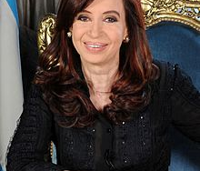
The President of Argentina.
The president of Argentina is Cristina Fernandez De Kirchner.
She was born on February 19, 1953
She’s the first elected Argentina female president.

Slide 3
Argentina’s Background
Includes history, famous explorers And languages spoken.

Slide 4
Argentina’s History
The earliest evidence of humans in Argentina was in 11,000 BC and was found in Patagonia. These finds were of the Diaguitas, huarpes, and sanavirones.
The Inca empire, under sapa-ince pachacutes, invaded and conquered present day north-western Argentina in 1480.

Slide 5
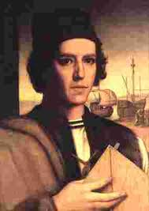
Argentina’s Famous Explorer.
One of Argentina’s famous explorer is Juan Diaz De Solis.
Juan was a Spanish navigator and explorer.
He was born January 20, 1470
Charrua Indians killed Juan and other men.

Slide 6
Languages Of Argentina
Argentina’s official language is Spanish.
Argentina has more then 1,500,000 Italian speakers.
Standard Germen is spoken by around 400,00 people.
200,000 people in Argentina speak Quechua.
Also other languages are spoken in Argentina.

Slide 7
Geographical makeup
Includes: coasts, mountains, deserts, valleys, etc. And Argentina’s population.

Slide 8
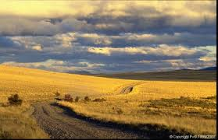
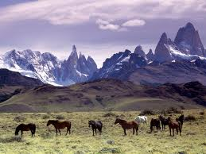
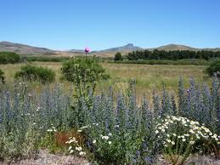
Coasts, mountains, deserts , valleys, etc.
Pampas are grasslands in Argentina.
Pampas are very famous there.
Andes are to the west of Argentina.
Grasses, trees and flourish are very rare in Argentina.

Slide 9


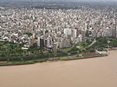
Argentina’s Population
Argentina’s population is 40,117,096.
Most people live in Buenos Aires with a population of 3,050,728.
The second rank with the most people is Cordoba. With a population of 1,371,000.
The third rank with the most people is Rosario. With a population of 1,242,000.

Slide 10
Argentina’s Economy
Includes: imports/exports, Agriculture, tourism, and monetary system.

Slide 11
Major Imports/Exports
Imports
Exports
Chocolate
Leather
Nuts
Fresh Grapes
Wine
Garlic
Vegetables
Animal Food
Line pipes
Beef
Soy Products
Wheat
Leather
Milk
Fruits
Cereals
Cotton
Fuel
Oil

Slide 12
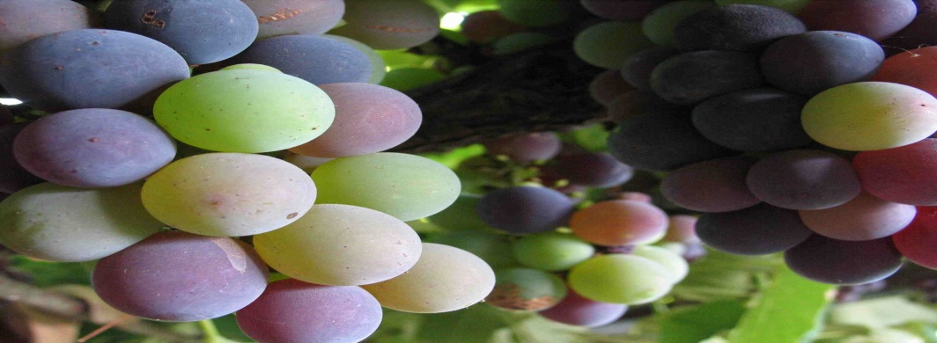
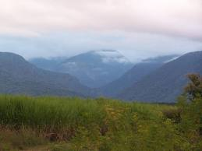
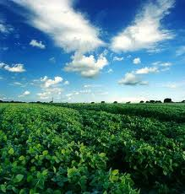
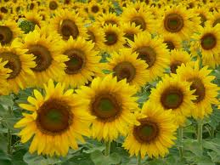
Argentina’s Agriculture
Grapes are grown in Argentina. The grapes are famous for making wines.
The Top 5 Harvest Productions:
Soybean
Maize
Sugar Cane
Wheat
Sunflower Seeds

Slide 13
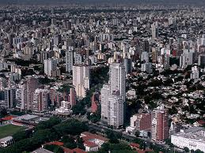
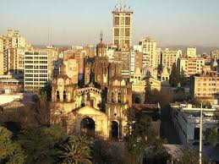
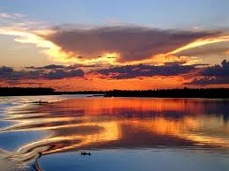
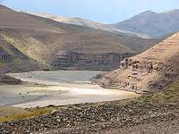
Tourism in Argentina
Famous Places To Go In Argentina:
Buenos Aires
Cordoba
The North
Patagonia

Slide 14
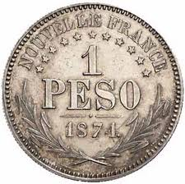
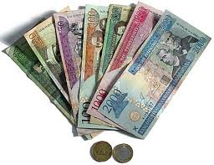
Monetary System In Argentina
Argentina uses peso’s and coins for their monetary system.

Slide 15
Customs And Religions Of Argentina
Includes: Religions, National Holidays, And Typical foods.

Slide 16
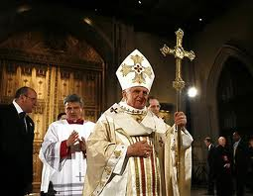

Religions In Argentina
Some Religions Of Argentina Are:
Roman Catholic
Christian
Agnostic
Muslim
Jewish
Buddhist & Other.

Slide 17
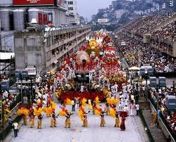
National Holidays
Some National Holidays In Argentina:
New Years
Carnival Day (Monday & Tuesday)
Good Friday
Christmas

Slide 18
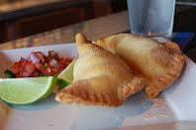
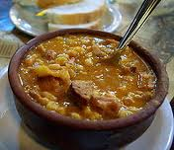
Typical Foods
Some Typical foods of Argentina:
Dolce De leche
Empanadas
Wine
Asado
Alfajores
Locro

Slide 19
The End ! ☺

