Slide 1
Cuba
By Breeanna White

Slide 2
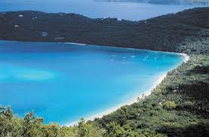
Caribbean Sea

Slide 3
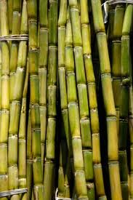
Sugar Canes in Cuba

Slide 4
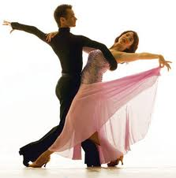
The Salsa Dance

Slide 5
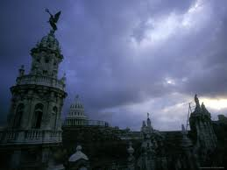
Downtown Cuba

Slide 6
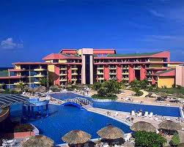
Tourism In Cuba

Slide 7
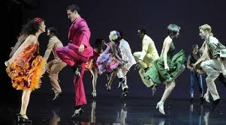
The Mambo Dance

Slide 8
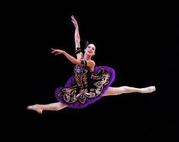
The Son Dance

Slide 9
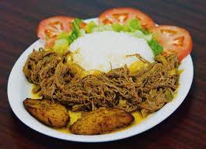
Cuban Food

Slide 10
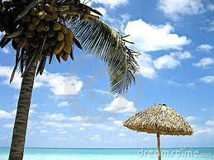
Paradise In Cuba

