Slide 1
Cuba
By vaughn

Slide 2
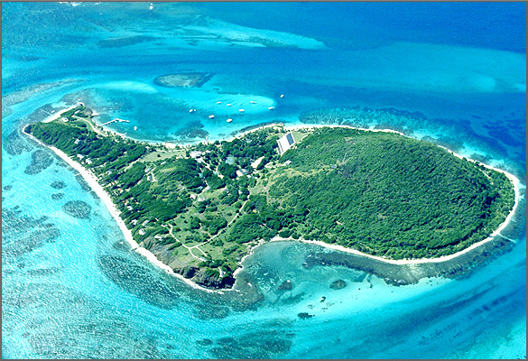
Carribean sea

Slide 3
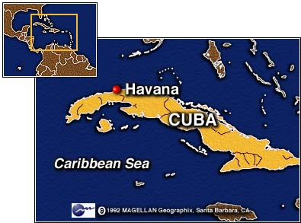
Cuba capital is havana

Slide 4
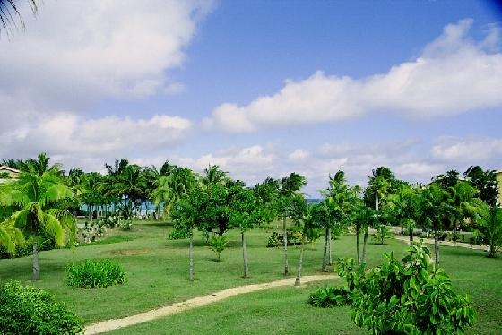
Cuba has good weather

Slide 5
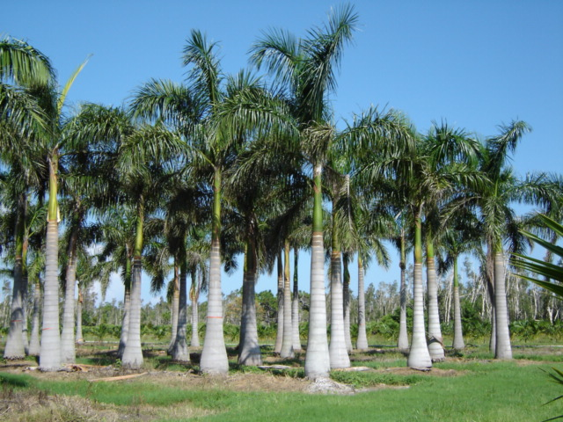
Palm trees are common in cuba

