Slide 1
Cuban facts
By : Will & Cassie

Slide 2
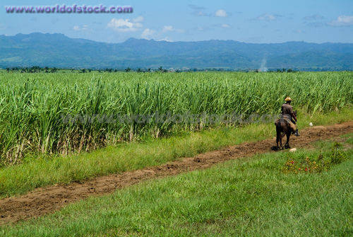
There was one country that supplied most of the world’s sugar. That country was Cuba!

Slide 3
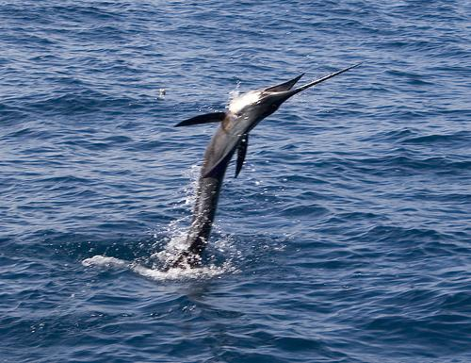
Cuba is located in the Carrabin Sea

Slide 4
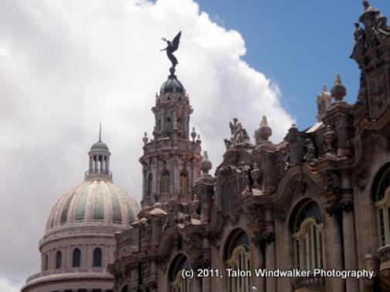
Cuba’s capitol is called Havana!!

Slide 5
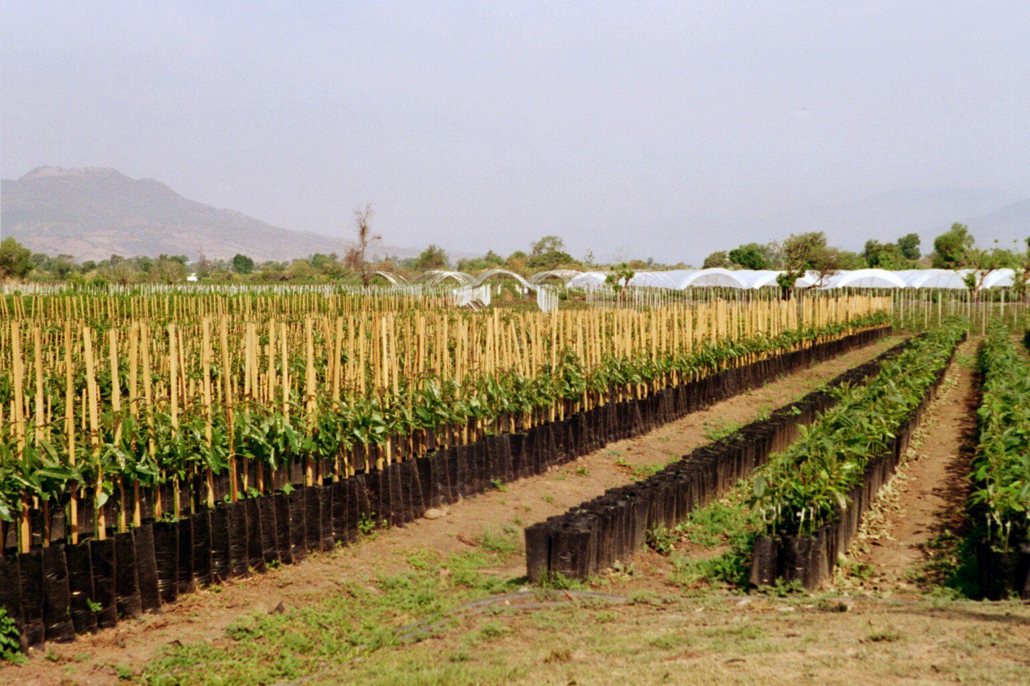
Cuba’s weather is good for growing sugar cane.

Slide 6
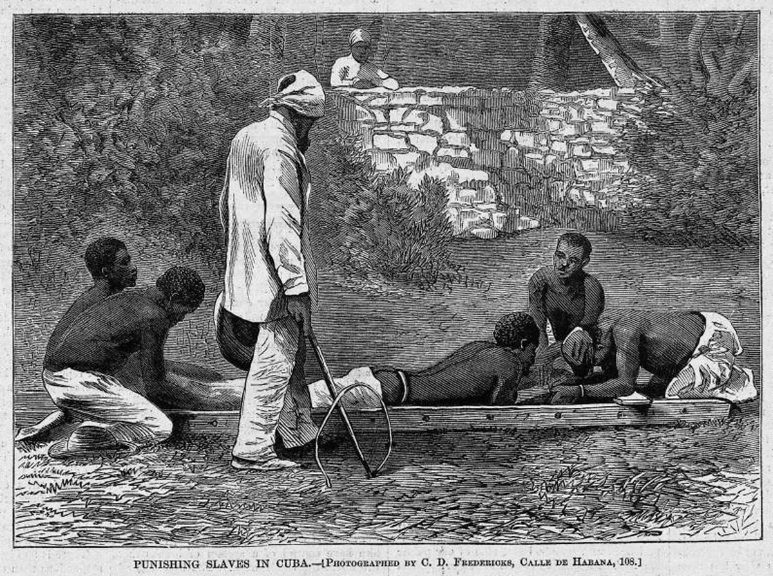
Humans came to the island of Cuba around 3500B.C. from south America.

Slide 7
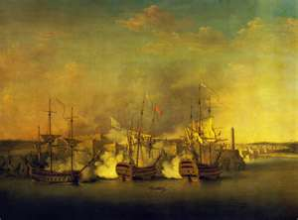
In June 1762 ,British troops invaded Cuba.

Slide 8
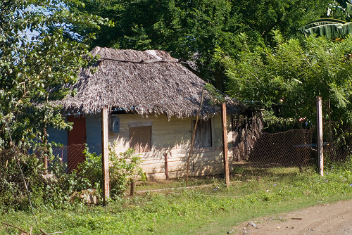
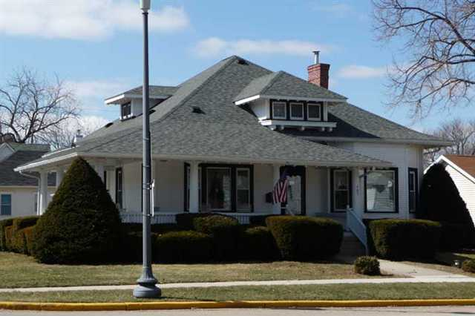
Daily life is Difficult for many Cubans. Most of their homes are crumbling. If their luck enough they can get a good house.

Slide 9
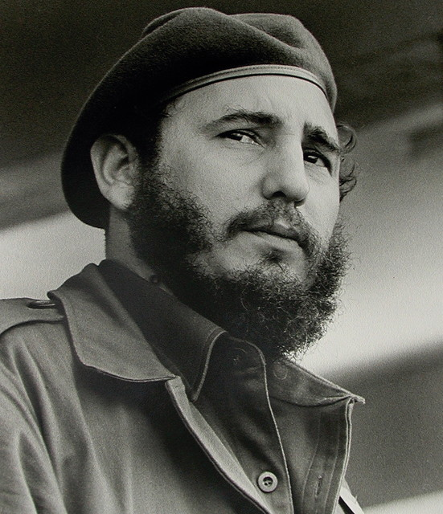
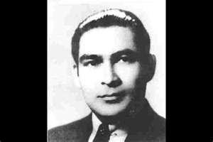
Batista was overthrown on January 1,1959, by a young lawyer named Fidel Castro.

Slide 10
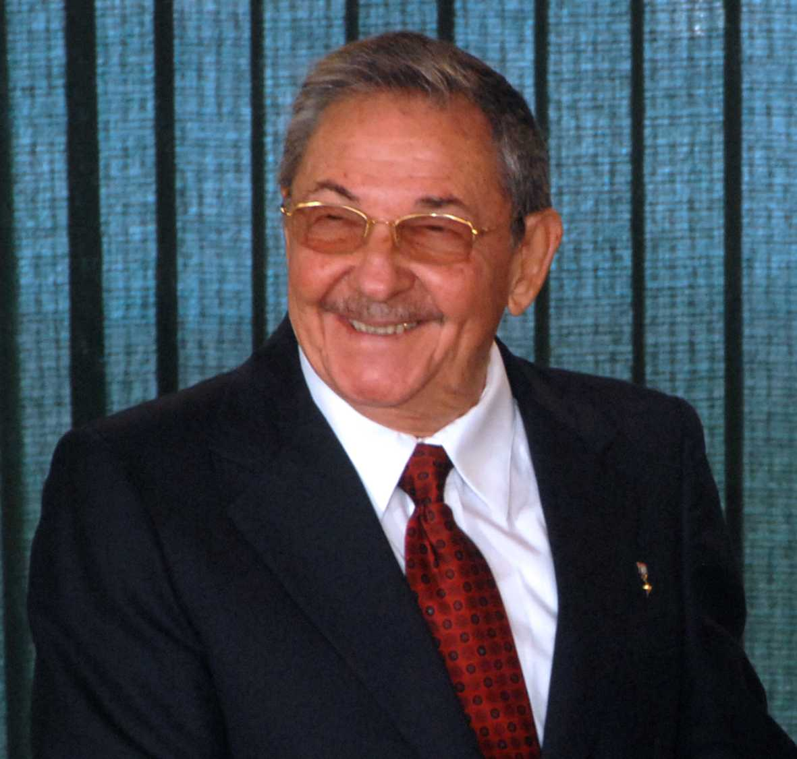
After Fidel Castro stepped down, his brother Raul took power in 2008.

Slide 11
                Thank you for watching
                By: Cassie

