Slide 1
CUBA=]
BY.CAITLYN,HSER EH

Slide 2
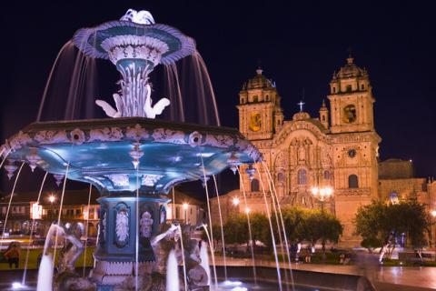
Cuba capital city is called havana

Slide 3
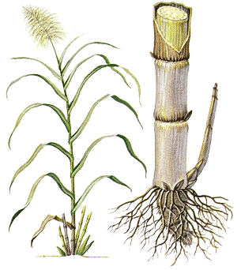
this is good to grow sugar canes

Slide 4
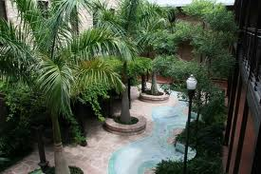
Palm trees are very commmon in Caba

Slide 5
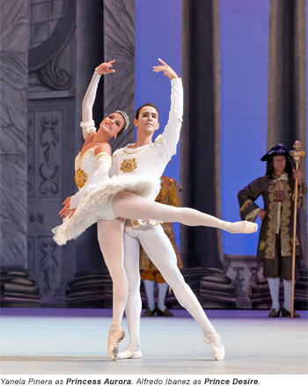
Dance is very important

Slide 6
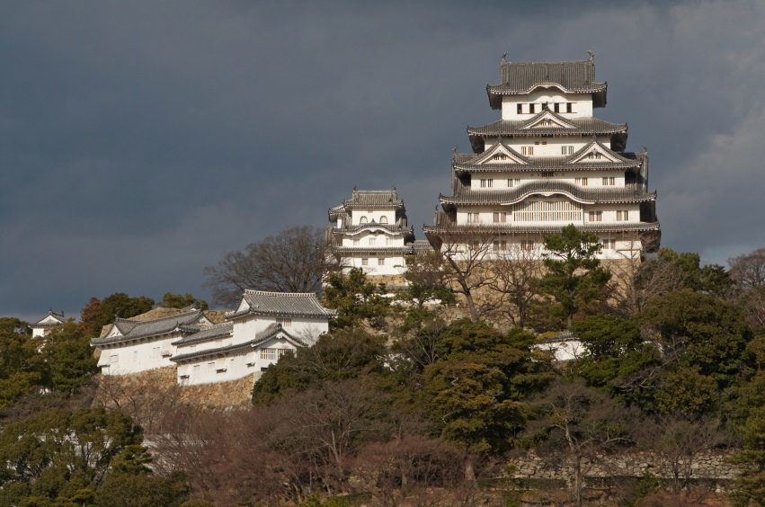
Humans first came to the island of cuba around 3500 bc from south america’n

Slide 7
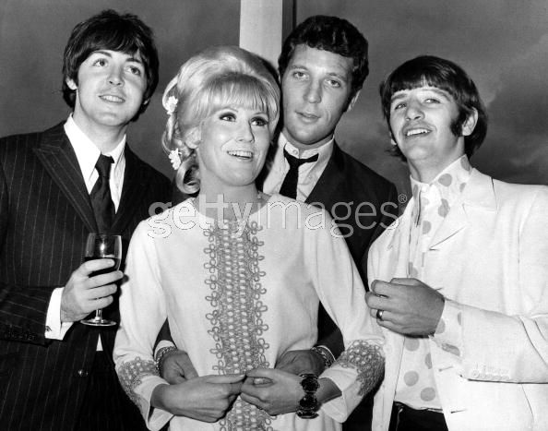
People all over the world try to imitate cuban music dances

Slide 8
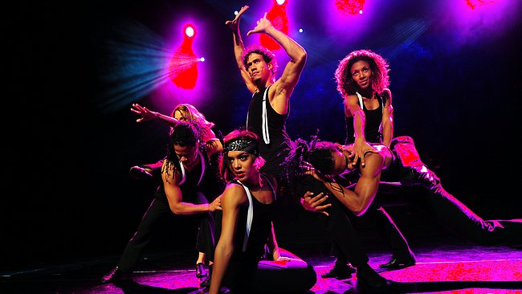
Cuba dance is romantic,beautiful,and very athletic

Slide 9
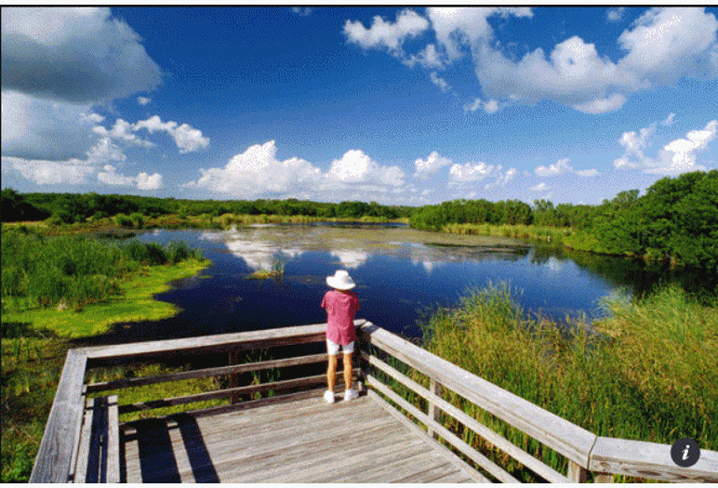
Spanish explorers settled in cuba

Slide 10
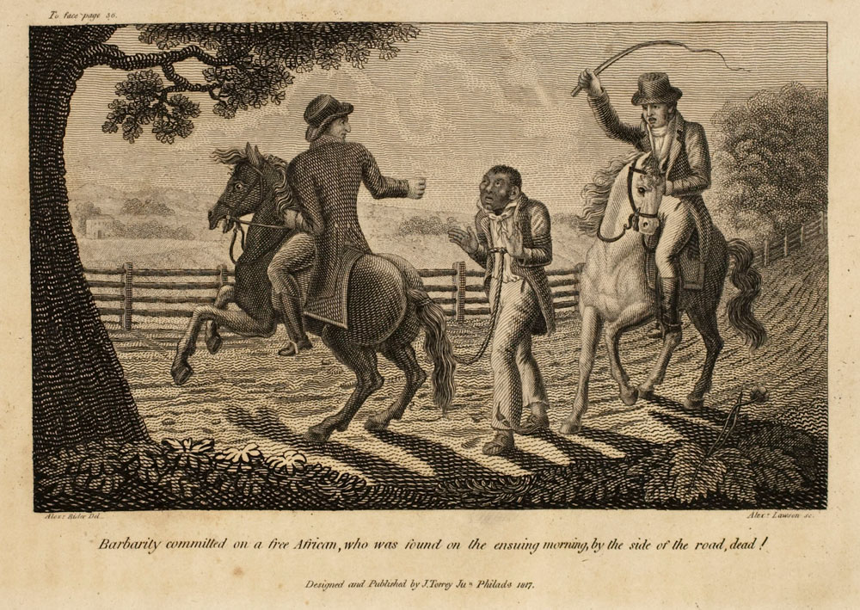
Later the british came andbrought with them slaves Afirca

Slide 11
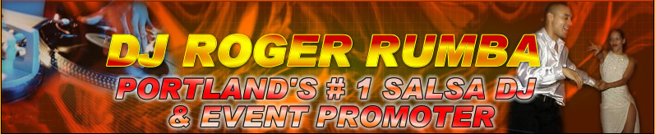
Rumba , mambo and salsa dancing

