Slide 1
cuba
By jairo

Slide 2
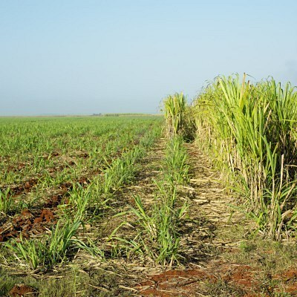
Cuba is the largest sugar proudes

Slide 3
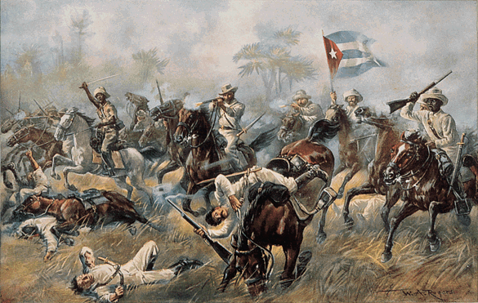
Cuba had a war

Slide 4
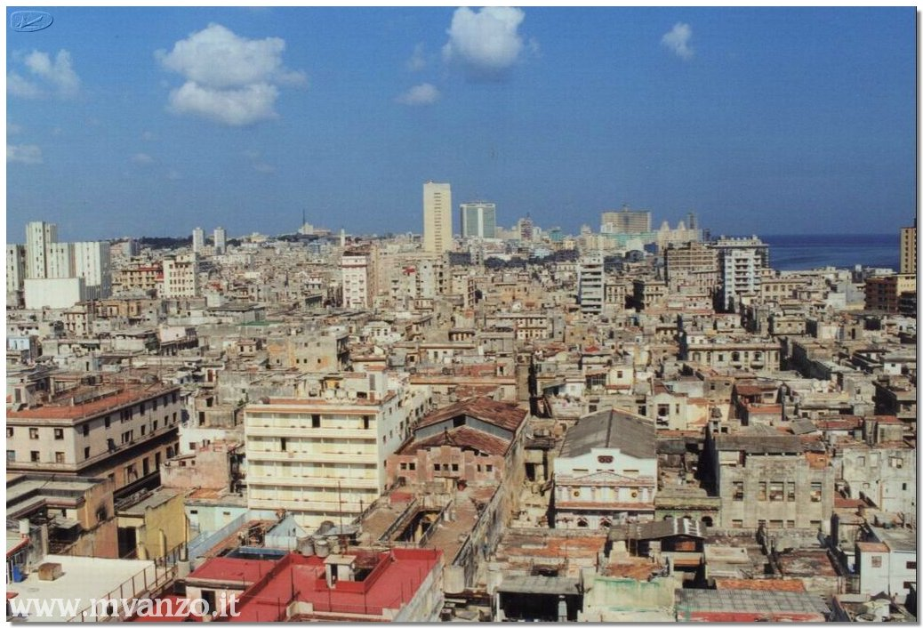
Cuba capital city is called havana

Slide 5
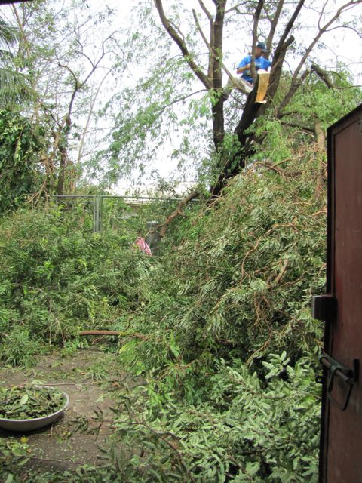
The pamas trees are common in cuba

Slide 6
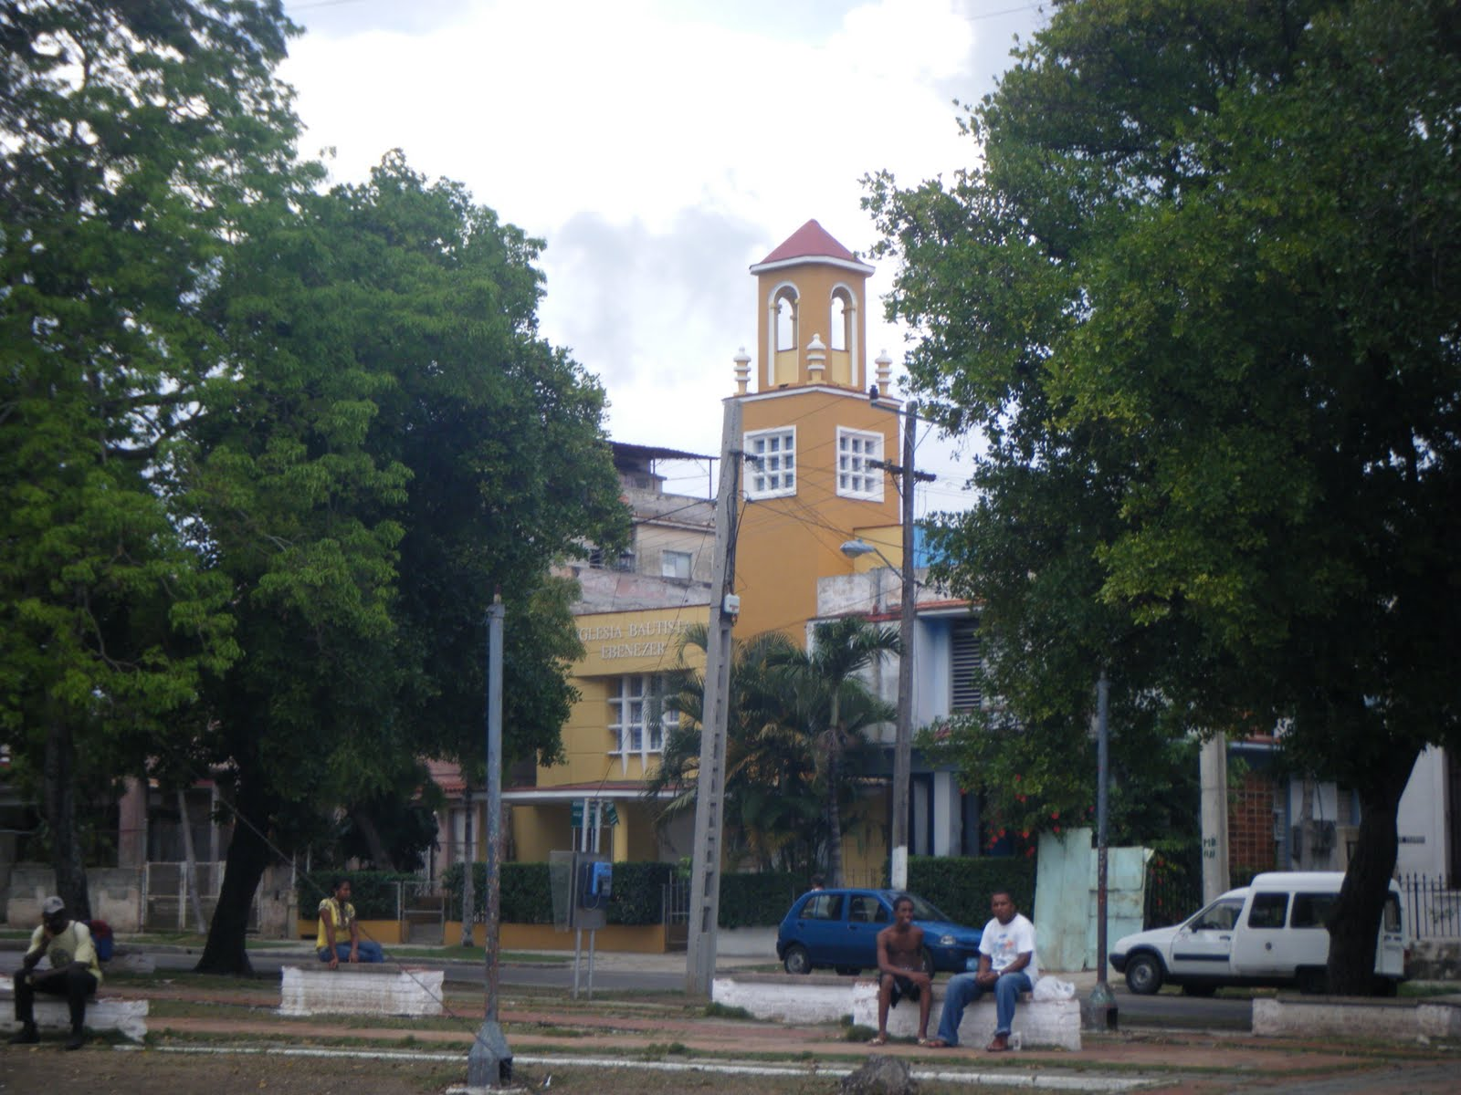
They covert christianity and dicover riches

Slide 7
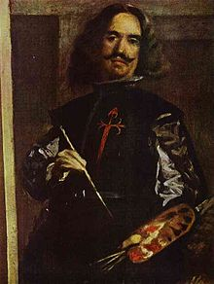
Deigo velazquez coquered the ilands of cuba for spain

Slide 8
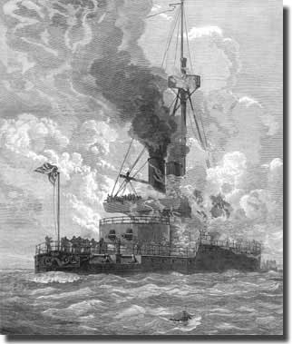
A ship explode in 1898 the usa

Slide 9
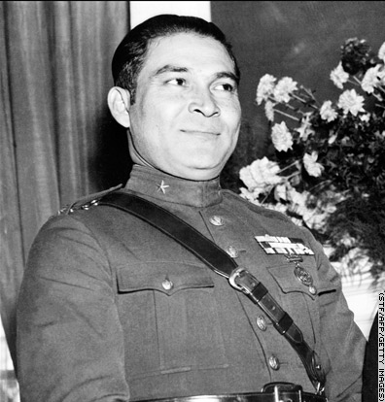
Batista took power during 20 year rule

Slide 10
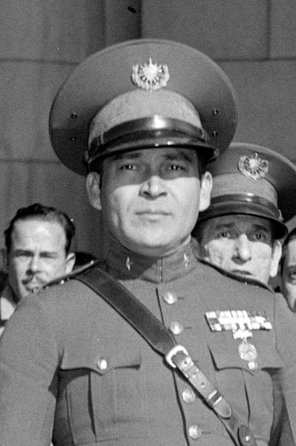
Batista got overthrown

