Slide 1
Cuba
by meghann fagen

Slide 2
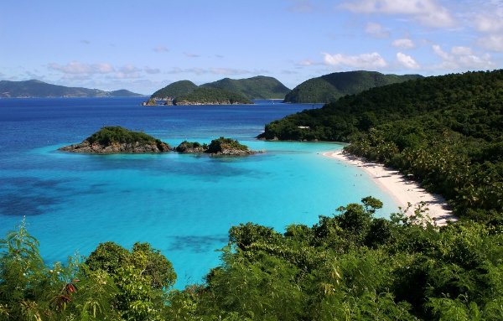
It is located in the caribbean sea.

Slide 3
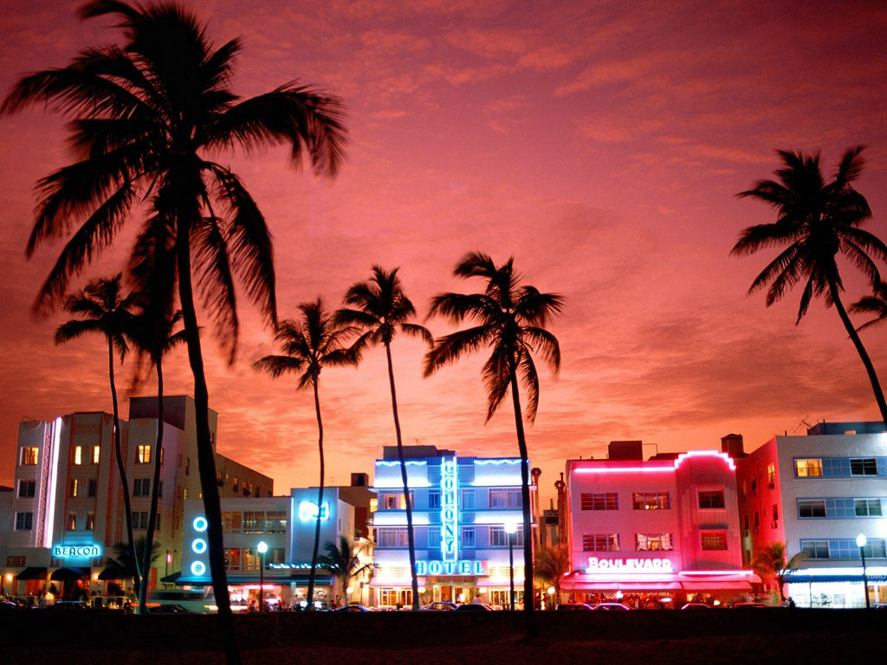
Palm trees are very common in cuba.

Slide 4
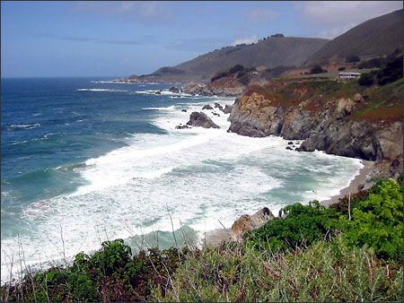
Spanish explorers setted in cuba.

Slide 5

Dance is very important.

Slide 6
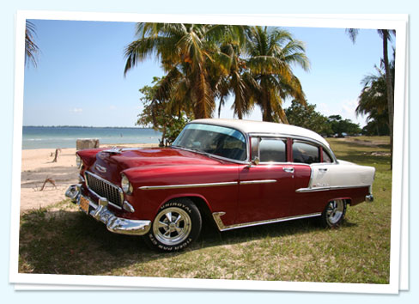

Cuba is an island nation it is located in the caribbean sea.

Slide 7
Later the British came and brought with them slaves from africa.

Slide 8
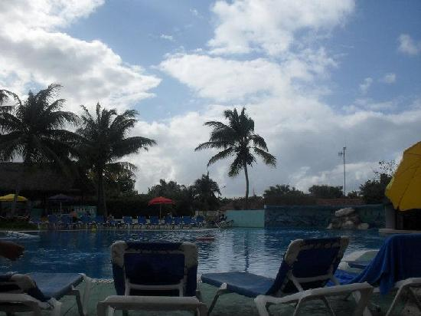
Cuba is a small poor country.

