Slide 1
Cuba history
By BAILEY JOHNSON

Slide 2
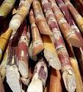
Cuba was the worlds most sugar.

Slide 3
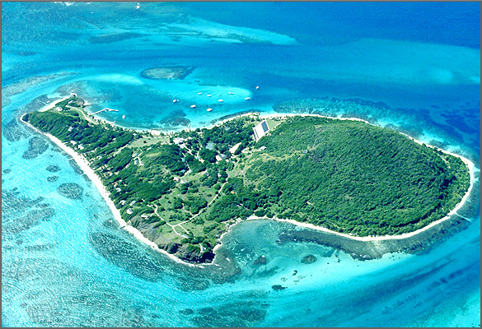
It is located in the Caribbean sea.

Slide 4
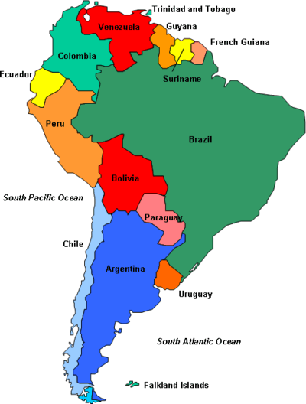
South Americans came to cube in 3500BC.

Slide 5
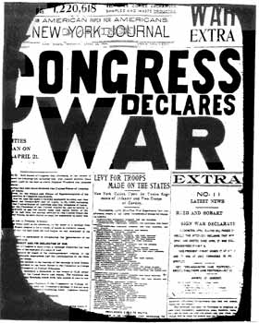
They had a war called the Spanish-American war

Slide 6
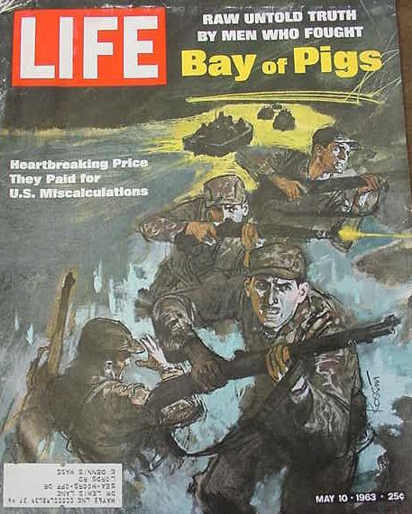
British troops came to invade Cuba

Slide 7
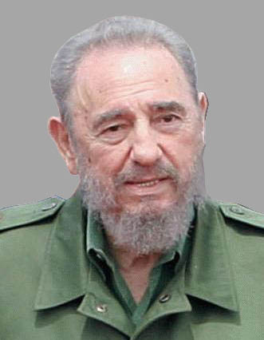
His brother Raul power in 2008

