Slide 1

cuba
By: alec alsager

Slide 2
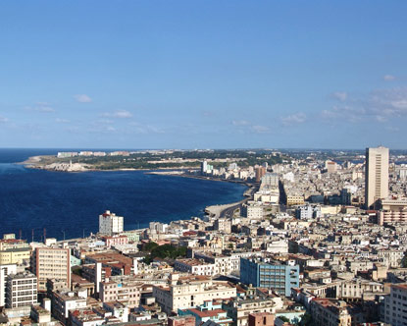
Cuba’s capital city is havana

Slide 3
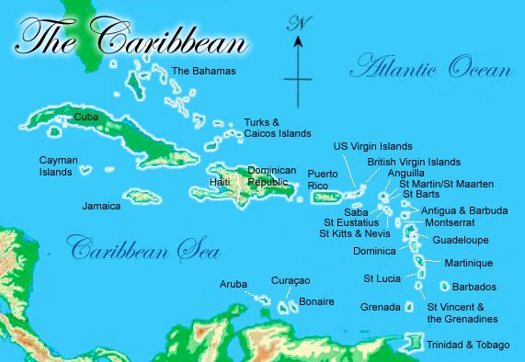
Cuba is the largest state in the Caribbean islands

Slide 4
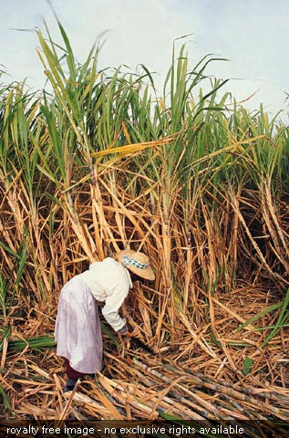
Cuba grows a lot of sugar canes

Slide 5
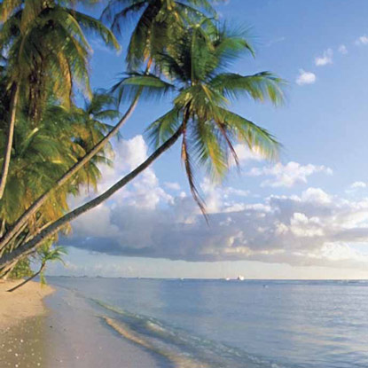
Cuba dose a lot of tourism

Slide 6
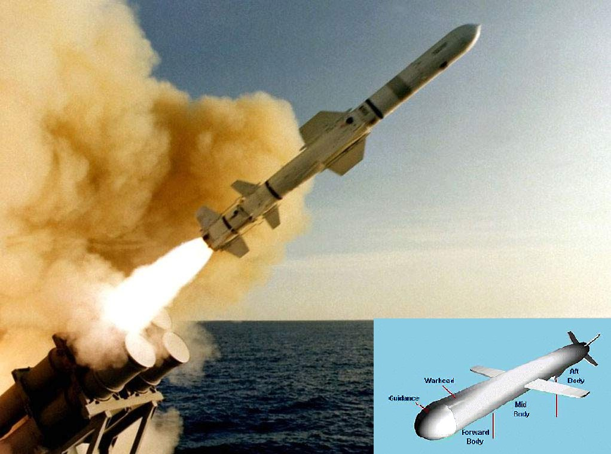
Cuba had a missile crisis in 1992

Slide 7
