Slide 1
Cuba
by:dalton lenihan

Slide 2

Sugar cane
Cuba make sugar cane.

Slide 3
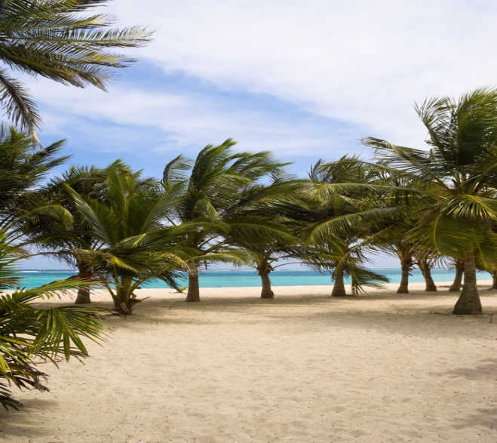
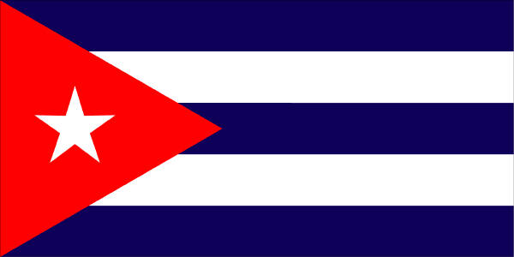
place
Caribbean sea
Cuba’s capital city is called havana.

Slide 4

weather
There is good weather in cuba.

Slide 5

palmtrees
Cuba has lots of palmtrees.

Slide 6

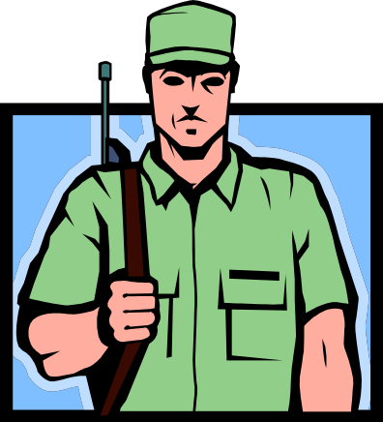
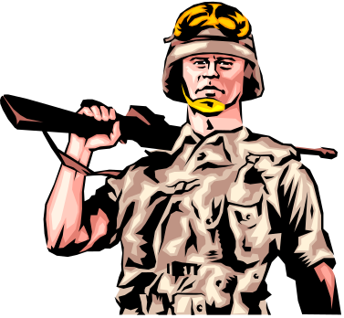
history
War was in cuba.

Slide 7
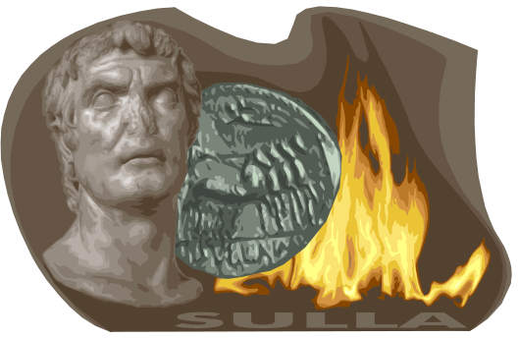
history
Fidel let his raul take power over cuba.

