Slide 1
CUBA
BY:HTEEKUPAW

Slide 2
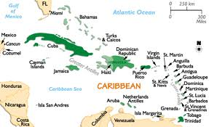
It is located in the Caribbean sea.

Slide 3
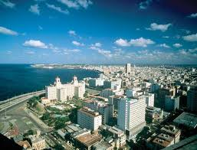
Cuba’s capital city is called Havana.

Slide 4
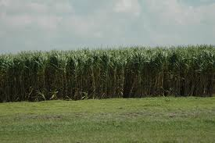
This is good weather for growing sugar cane.

Slide 5
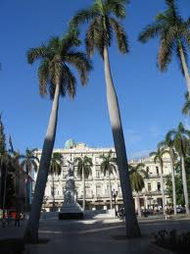
Palm tree are very common in
Cuba.

Slide 6
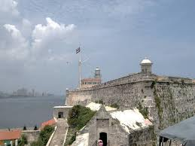
In June 1762,British troops invaded
Cuba.

Slide 7
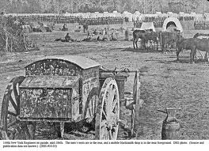
The U.S. went to war with Spain.

Slide 8
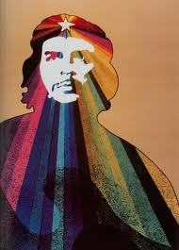
Batista was overthrown on January
1,1959,by a young lawyer named Fidel castro.

Slide 9
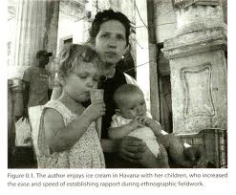
Daily life for average Cabans is difficult.

Slide 10
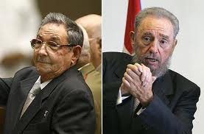
His brother Raul took power in 2008.

