Slide 1
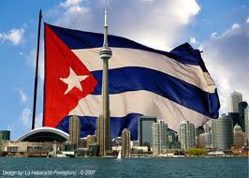
Cuba History
By Melanie Chavez

Slide 2
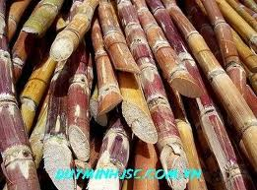
Cuba was the country that supplied most of the world’s sugar.

Slide 3
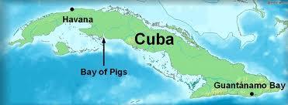
Cuba is located in the Caribbean sea.

Slide 4
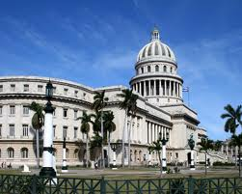
Cuba’s capital is Havana.

Slide 5
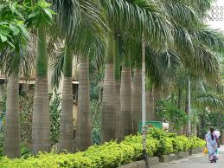
Palm trees are very common in Cuba

Slide 6
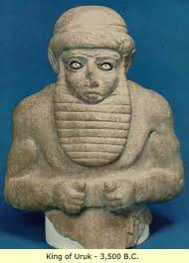
Humans first came to the islands of Cuba around 3500 BC from South America

Slide 7
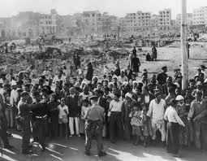
In June 1762,British troops invaded Cuba

Slide 8
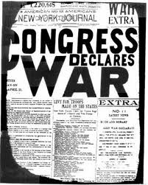
The U.S went to war with Spain

Slide 9
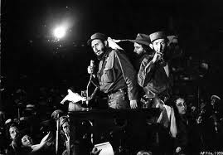
Batista was overthrown on January 1,1959,by a young lawyer named Fidel Castro

Slide 10
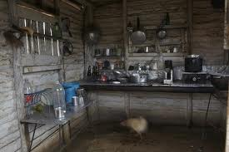
Daily life for average Cubans is difficult

Slide 11
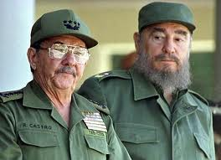
After Fidel’s Castro stepped down , his brother Raul took over in 2008

