Slide 1
Cuba
BY: Zackery Elwood, and rickie green

Slide 2

Who supplied the most sugar?
Cuba.

Slide 3
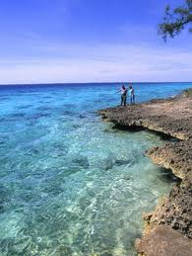
Cuba is located in the Caribbean sea.

Slide 4
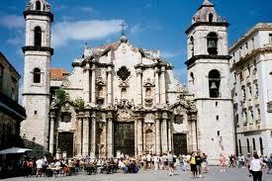
The capital of Cuba
Havana

Slide 5
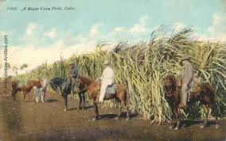
Cuba grows a lot of sugar cane

Slide 6
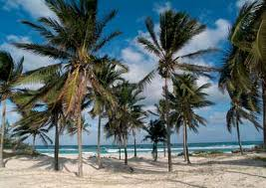
Palm trees are very common in Cuba

Slide 7
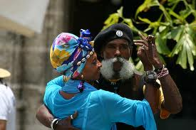
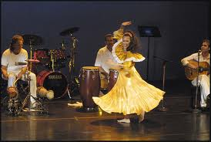
Cuba is commonly known for dancing

Slide 8
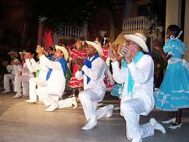
Cuba dancing is Rumba, Mambo, Salsa

Slide 9
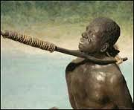
Later the British brought Slaves

Slide 10
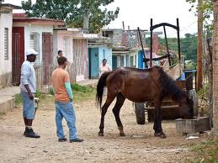
Cuba is a small poor country

