Slide 1
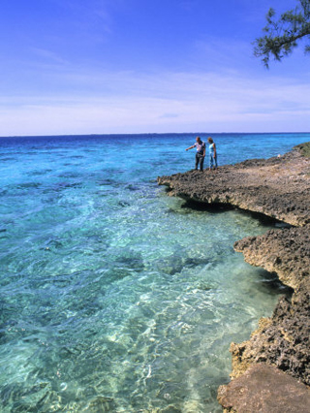
C
UBA

Slide 2
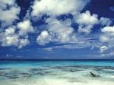

Located in the Caribbean sea.

Slide 3
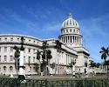
Cuba’s is Havana

Slide 4
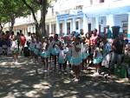
COIMING TO CUBA
Humans first came to the island of Cuba around 3500 BC from South America.

Slide 5
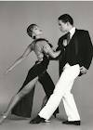
Dancing is very important to Cubans

Slide 6
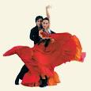

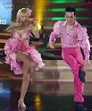

Dance styles include the son ,Rumba,Mambo,Salsa,

Slide 7

Cubans dance
Romantic , beautiful ,and very athletic.

Slide 8

Things grown in Cuba.
Sugarcane is grown in Cuba .Cuba has a lot of sugarcane .Cuba sends it all around the world .

Slide 9

Trees
Palm trees are found in Cuba.

Slide 10

Some believe that music is the only way to talk to the dead

Slide 11

Cuba is a very poor and small country

